Slide 1

Copertina
Notes:
textbox
No alt text provided
textbox
No alt text provided
textbox
No alt text provided
shape
No alt text provided
Report aggiornato al:
No alt text provided
textbox
No alt text provided
textbox
No alt text provided

Slide 2
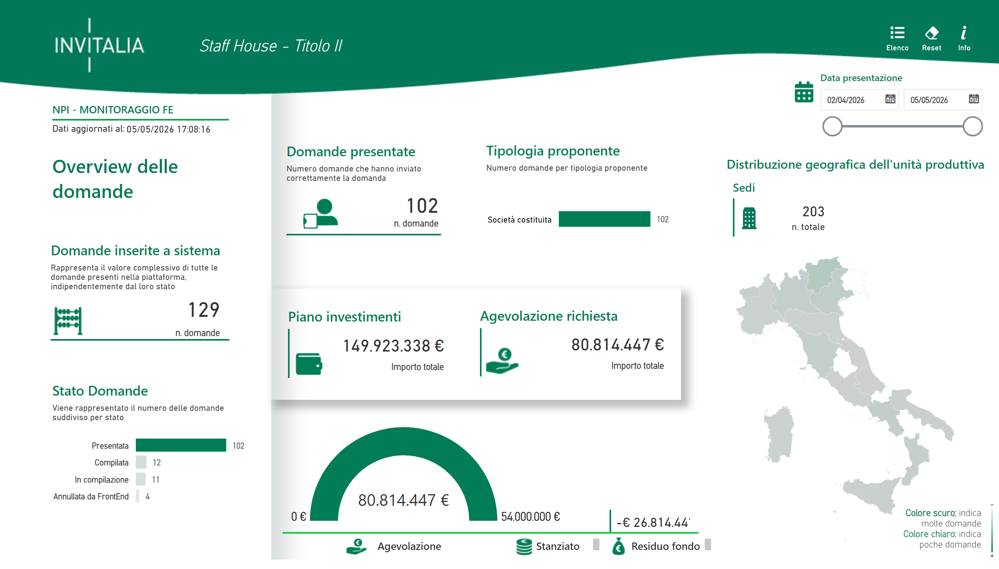
Overview
Notes:
image
No alt text provided
image
No alt text provided
Residuo fondo
No alt text provided
Tipologia proponente
No alt text provided
image
No alt text provided
shape
No alt text provided
shape
No alt text provided
textbox
No alt text provided
Domande presentate
No alt text provided
image
No alt text provided
Domande inserite a sistema
No alt text provided
image
No alt text provided
textbox
No alt text provided
textbox
No alt text provided
Report aggiornato al:
No alt text provided
shape
No alt text provided
image
No alt text provided
Sedi
No alt text provided
image
No alt text provided
Data presentazione
No alt text provided
Piano investimenti
No alt text provided
card
No alt text provided
card
No alt text provided
Borghi
No alt text provided
textbox
No alt text provided
textbox
No alt text provided
image
No alt text provided
textbox
No alt text provided
Mappa
No alt text provided
textbox
No alt text provided
shape
No alt text provided
image
No alt text provided
image
No alt text provided
textbox
No alt text provided
image
No alt text provided
image
No alt text provided
textbox
No alt text provided
Stato Domande
No alt text provided
shape
No alt text provided
image
No alt text provided
Agevolazione richiesta
No alt text provided
shape
No alt text provided

Slide 3
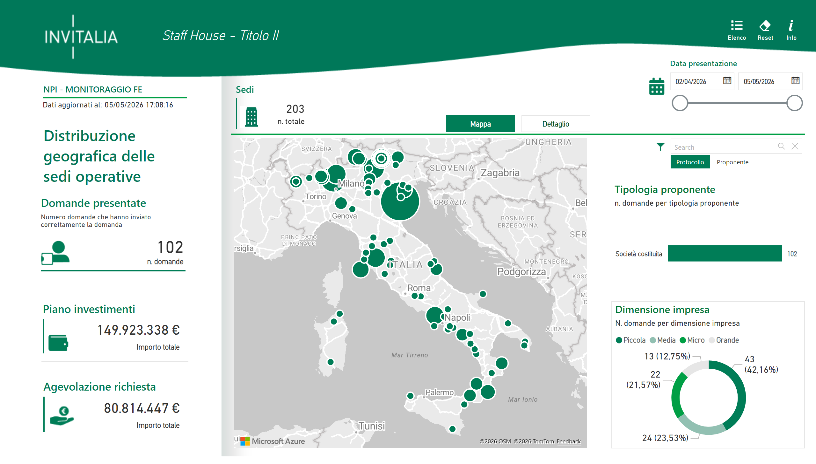
Distribuzione Geografica
Notes:
Tipologia proponente
No alt text provided
textbox
No alt text provided
Domande presentate
No alt text provided
image
No alt text provided
card
No alt text provided
shape
No alt text provided
image
No alt text provided
textbox
No alt text provided
image
No alt text provided
image
No alt text provided
image
No alt text provided
textbox
No alt text provided
shape
No alt text provided
image
No alt text provided
azureMap
No alt text provided
card
No alt text provided
Agevolazione richiesta
No alt text provided
shape
No alt text provided
textSearchSlicerF85E2E78BE4A4D7D9F99ED75B5D71C85
No alt text provided
shape
No alt text provided
Data presentazione
No alt text provided
textbox
No alt text provided
Sedi
No alt text provided
bookmarkNavigator
No alt text provided
image
No alt text provided
shape
No alt text provided
textbox
No alt text provided
Dimensione impresa
No alt text provided
image
No alt text provided
image
No alt text provided
image
No alt text provided
shape
No alt text provided
Report aggiornato al:
No alt text provided
pivotTable
No alt text provided
Piano investimenti
No alt text provided
image
No alt text provided

